Slide 1
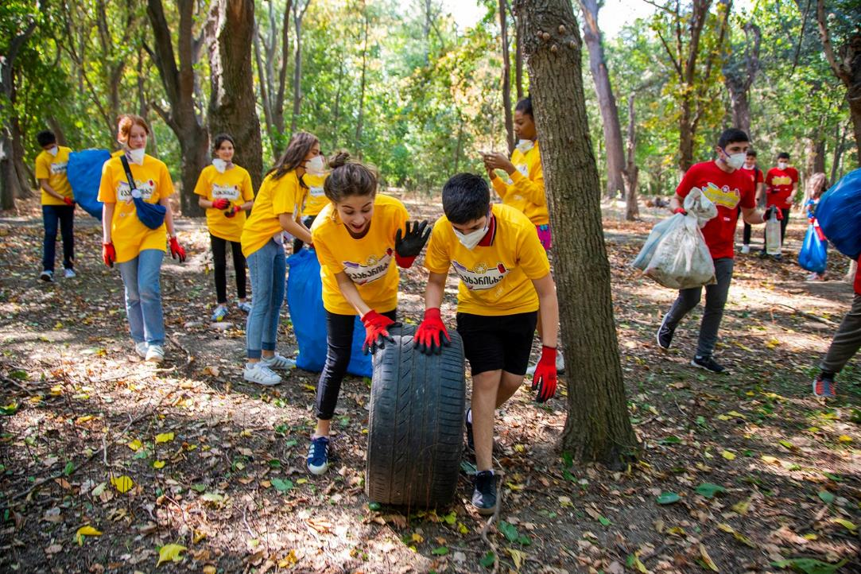
Waste Management Technology in Regions – WMTR II
Nino Shavgulidze
Chief of Party
October 8, 2019
Tbilisi

Slide 2
CENN - a non-governmental organisation working to protect the environment by fostering sustainable development

Slide 3
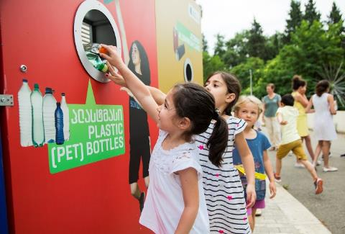
Program – Waste Management Technology in Regions
Implementing organization: CENN
Duration: 2014 –2020
Geographic coverage: Kakheti, Shida Kartli, Adjara AR and Tbilisi
Main directions:
• Implementing an Integrated Waste Management System
legislative development, implementation, closing illegal landfills, establishing a waste recycling system
• Private Sector-Led Recycling
Improving operations, processing more waste, increasing the amount of recycled products
• Illegal Dumping Penalties and Tariff Policy
Ensuring self-reliance of the waste management sector
• Public Outreach
Education, capacity building, awareness raising

Slide 4
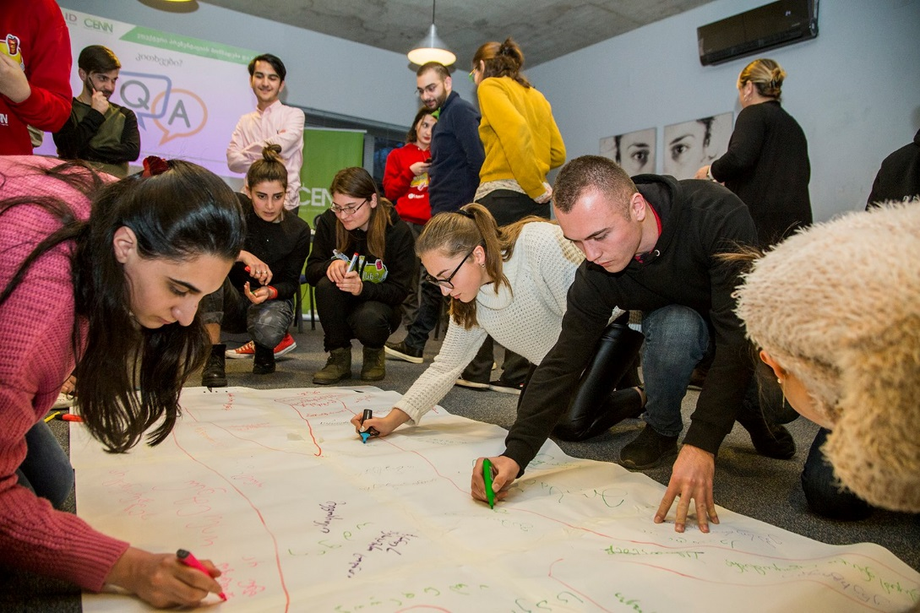
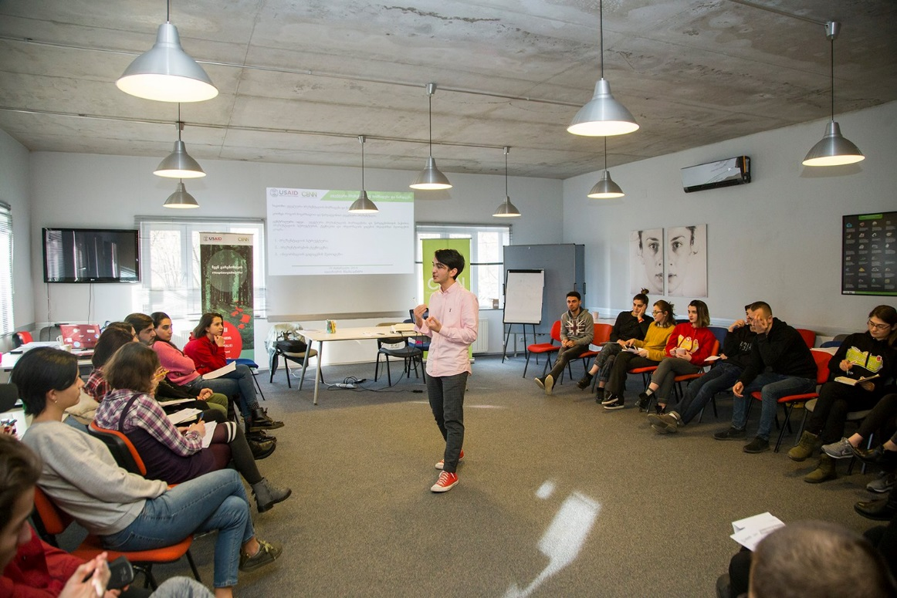
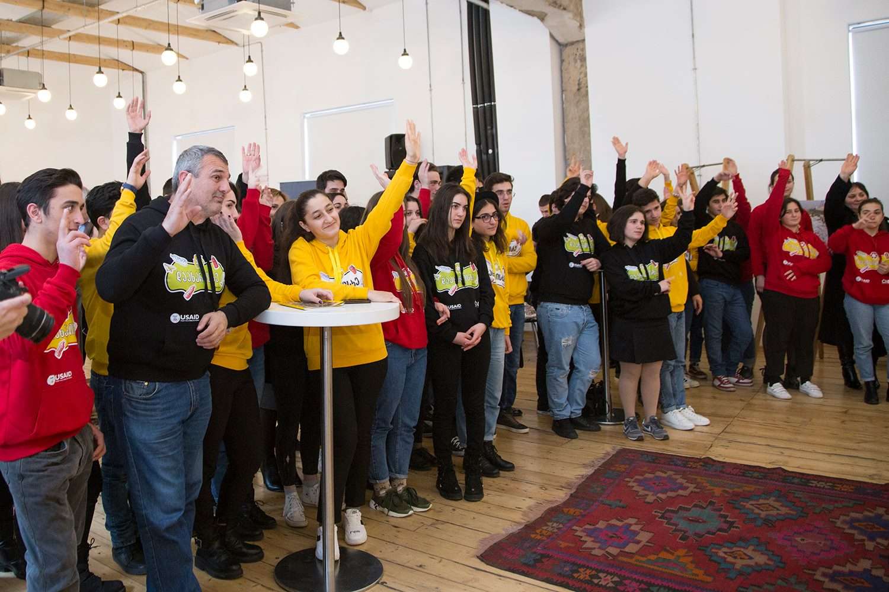
Educational activities – Our assistance:
Improving current programs or developing new programs
Local and international expertise
Consultations and mentorship to successfully introduce programs
Help with organizing workshops, seminars, conferences
Activities for students
Discussions
Debates
Green camps
Competitions
Clean-ups
Eco festivals
Film screenings

Slide 5
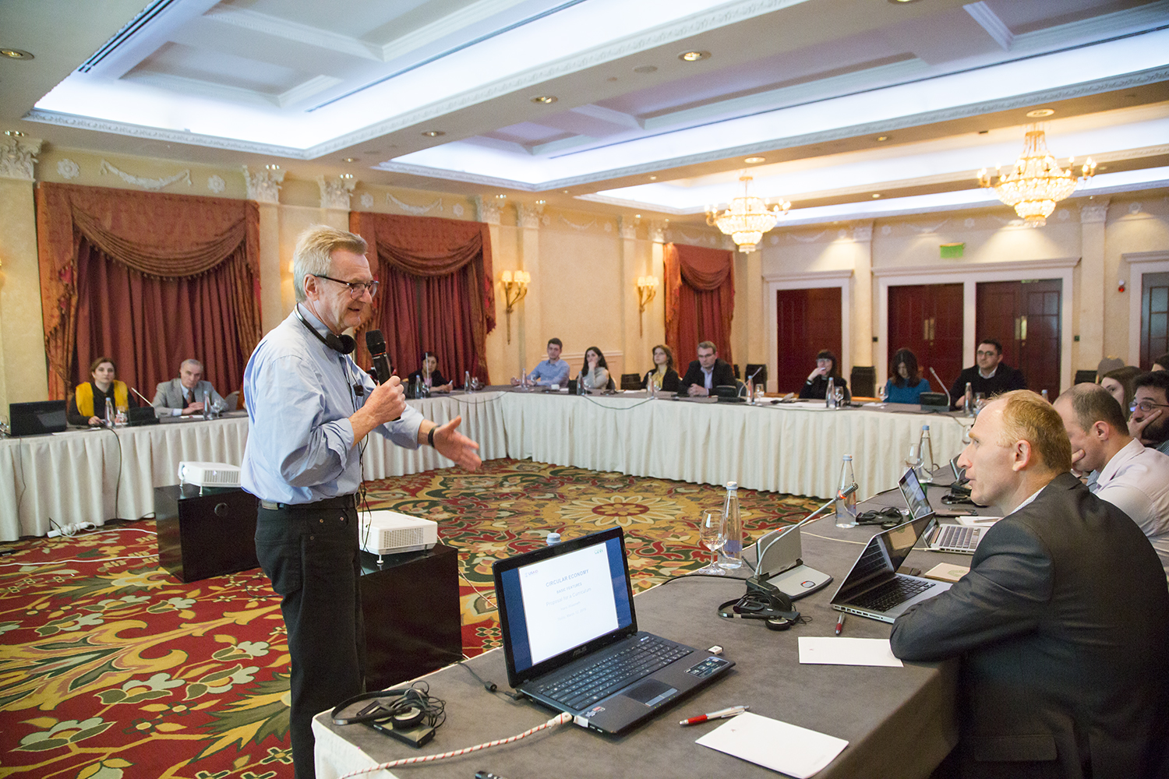
Sub-grants:
Up to 10,000 USD sub-grants issued for 5 NGOs
Up to 600 USD sub-grants issued for 6 Schools
Circular Economy Course for Universities
Workshop for 10 universities:
Tbilisi State University
Ilia State University
International Black Sea University
ISET Policy Institute
European University
Caucasus University
Sabauni - Sulkhan-Saba Orbeliani University
Telavi State University
Guram Tavartkiladze Teaching University
Georgian Aviation University

Slide 6
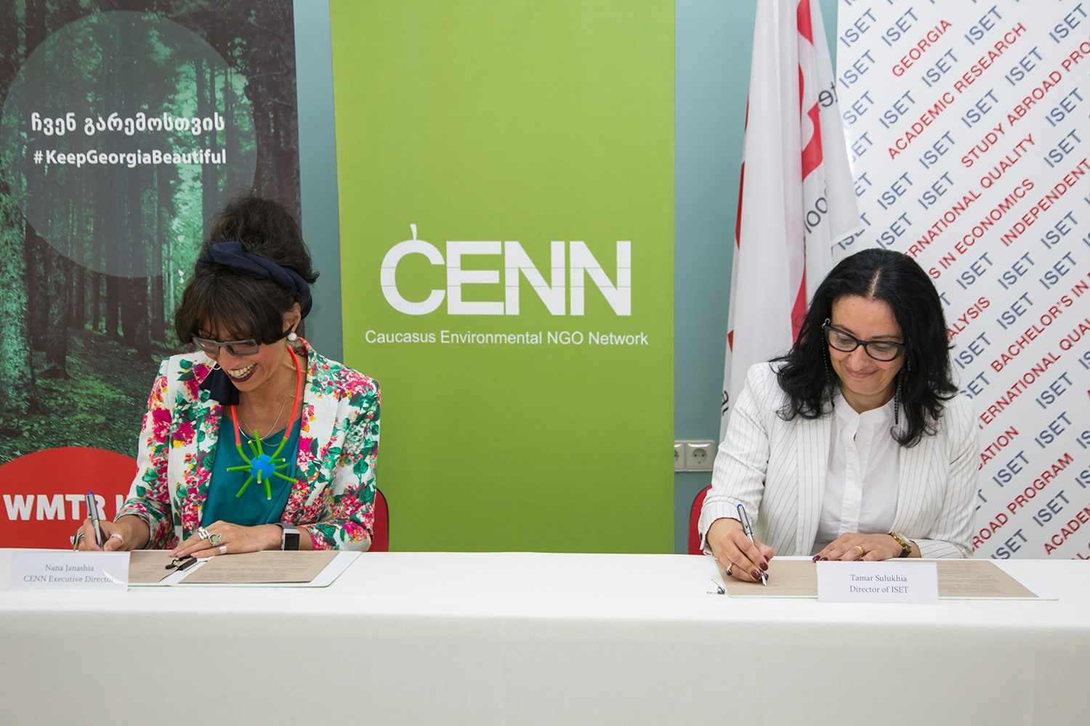
Cooperation with ISET:
A half-year course for third-year Bachelor students
Memorandum of Understanding signed between CENN and ISET
A lecturer appointed by ISET
Consultations and mentorship provided by an
international expert
Students will be involved in studies related to the course
Cooperation with other universities:
Assistance in formal and informal educational processes

Slide 7
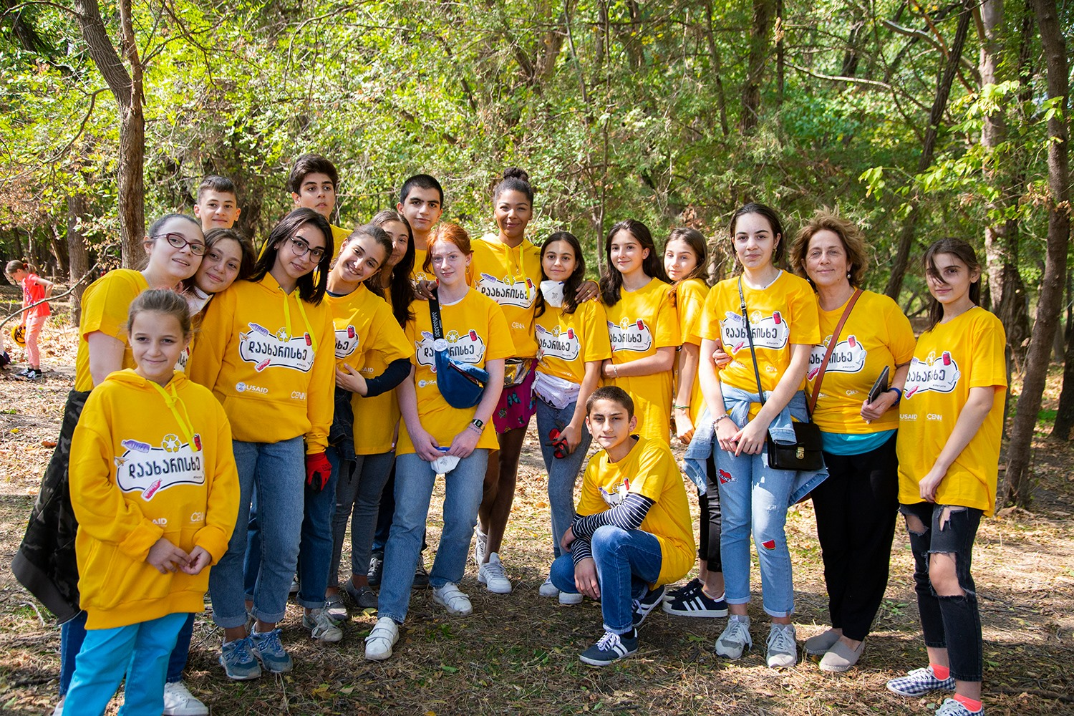
Thank You

